Slide 1

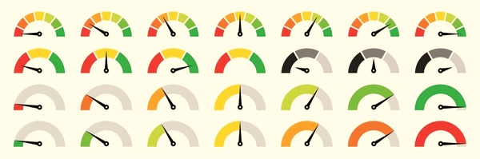


MORTGAGE PAYMENT ANALYSIS
PREDICTIVE MODELING FOR RESIDENTIAL MORTGAGE RISK ANALYSIS

Slide 2
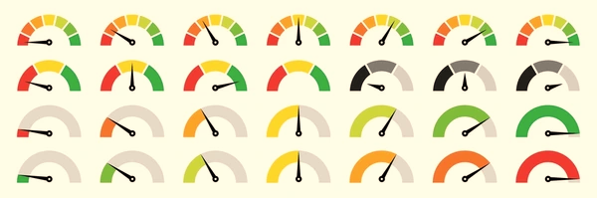
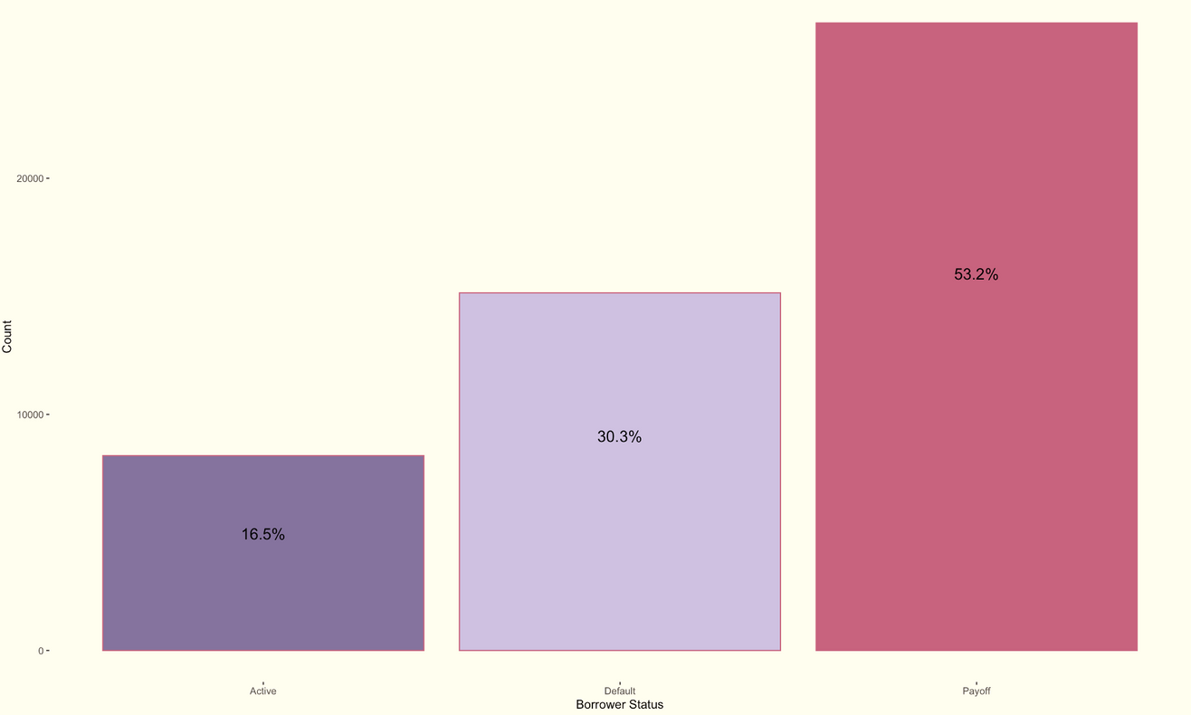
GOALS
Identify customers who are likely to default.
Assess risk levels by predicting default likelihood at various stages of loan tenure.
Analyze behavior patterns of defaulting customers.
Current Borrower status

Slide 3

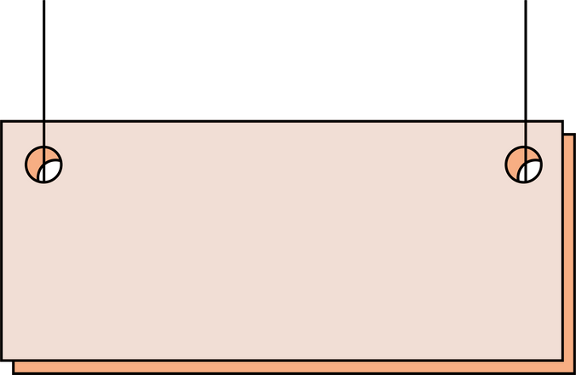
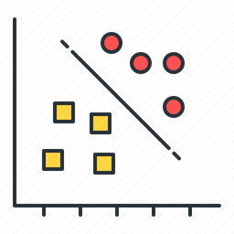


DATA SAMPLING
complete dataset
~600K
Cluster Analysis
Grouped by customers
~49K
Testing
Training
Classification
Active customers
Inactive customers
~8K
~41K
Regression
Prediction
Trained model

Slide 4

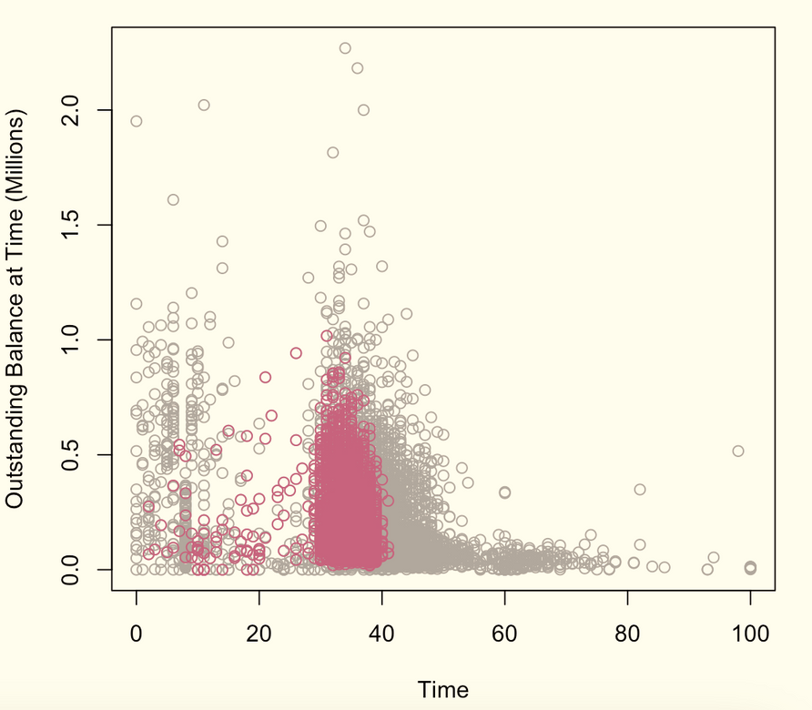
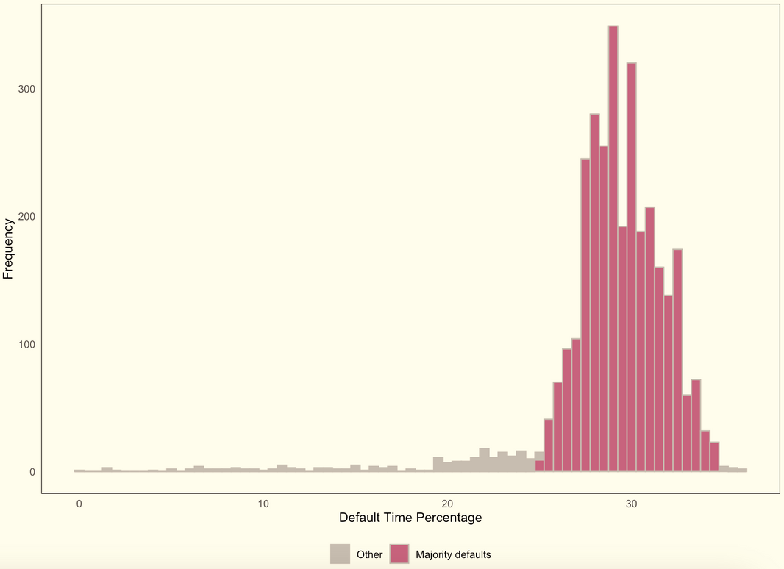
ACTIVE CUSTOMER PREDICTION
Segmentation of customers using
Naive Bayes classifier.
Predicting the % of loan tenure at which customers
are likely to default using MLR.
39.12% are likely to default.
93.43% default between 25 - 35% of their loan tenure.
Notes:
Naïve Bayes:
# Accuracy 0.7586, Sensitivity 0.7089, Specificity 0.7863
Multiple Linear Regression:
# cor = 0.9756536, MAE = 0.5688009, RMSE = 1.729241
39%(8251) = 3228
93%(3228) = 3002.04 will default during 30-42 periods

Slide 5

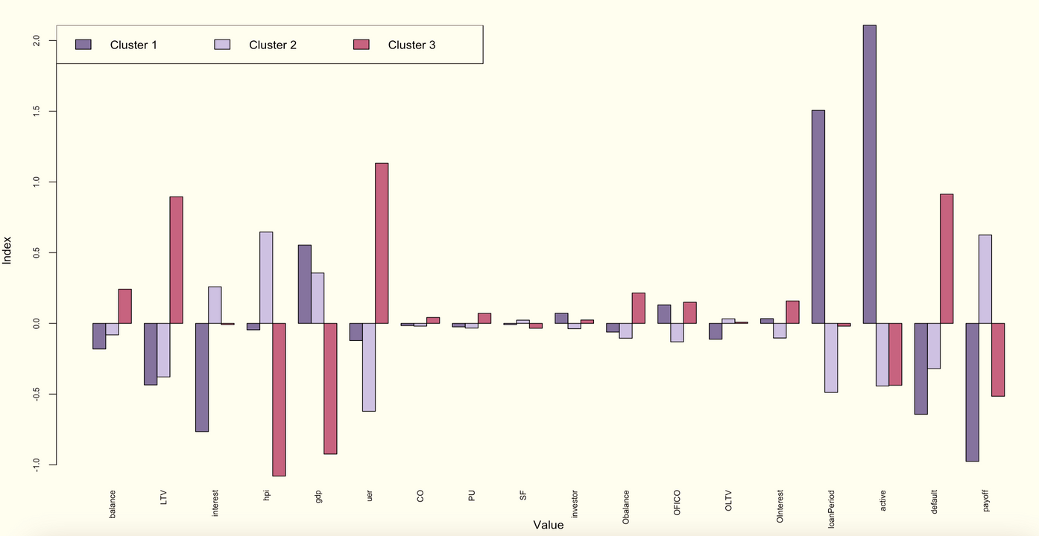
DEFAULT CUSTOMER BEHAVIOR
Large Loan Amounts.
substantial portion financed by debt due to high LTV ratios.
Preference for Condominiums or Planned Urban Developments.
Sensitivity to Economic Indicators.
Investment Orientation.
Relatively Good FICO Scores.

Slide 6

RECOMMENDATIONS
Avoidance: Avoid new customers posing very high risk (defaulting very early). Additionally avoid customers even with low risk, during economic downturns.
Reduction: Implement early warning systems to identify customers nearing the critical default risk period (25-35% of loan tenure) and intervene proactively.
Transference: Transfer high-risk mortgages to other financial institutions to liquidate, reallocating funds to lend to potential pay-off customers.
Use factors other than FICO: to assess the capability of loan repayments, by assessing their income stability, debt-to-income ratios, by requiring collaterals or using insurance to secure the loan.

Slide 7

THANK YOU
Lavanya Govindarajan

